Slide 1
The Battle of Neighborhood

Slide 2
Introduction
This project is to take a glimpse at different neighborhoods of Paris.
Travelers from inside and outside of area who want to decide where to visit and business owners may be interested in the project.
Paris is a tourist destination. Entire Paris is broken into 20 arrondissements (politically divided). Let’s explore Paris and understand which arrondissements are good for travelers & business owners and also have a look at highly populated areas too.

Slide 3
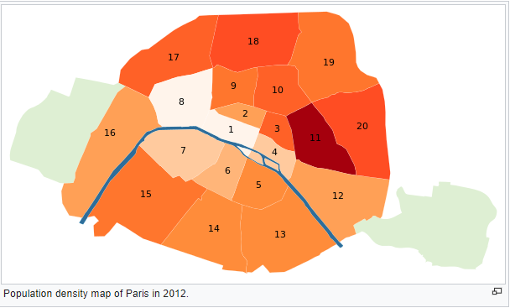
Data
Paris is divided into 20 Arrondissement (municipal areas). We are going to explore these 20 arrondissements and find out what are the highly visited places.
Also, we will pick up the highly populated areas and explore the venues in these areas
https://en.wikipedia.org/wiki/Arrondissements_of_Paris

Slide 4
Methodology
1. Data scraping from Wikipedia. Pull out the 20 arrondissements, population.
https://en.wikipedia.org/wiki/Arrondissements_of_Paris
2. Use Geopy to get Longitude and Latitude of all the 20 arrondissements
3. Use FourSquare API to get nearby venues
4. Use KMeans clustering from sklearn to cluster 20 arrondissements based on their most visited venues and group them into 4 clusters. I can take 5 or more clusters. It becomes too diluted. Hence, I am sticking to 4 clusters only.
5. Explore these 4 clusters and provide analysis

Slide 5
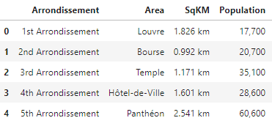
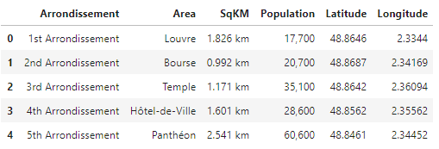
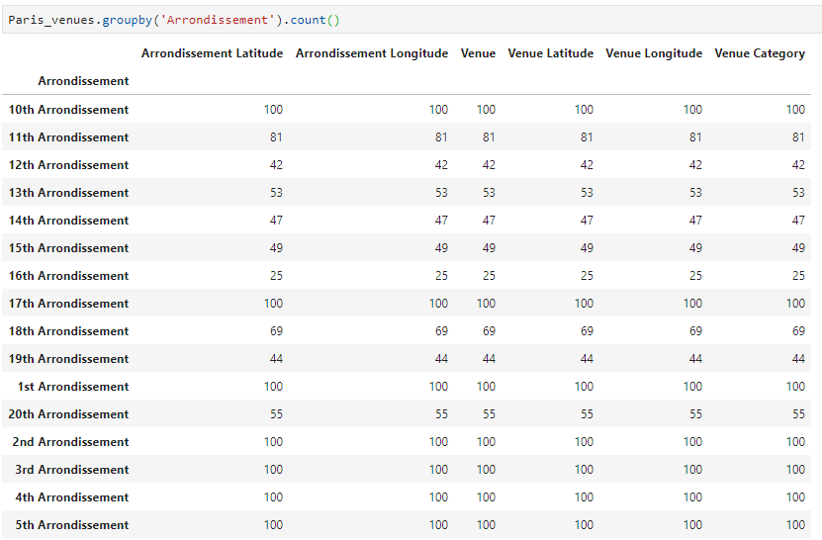

1. Snapshot of Data from Wikepidea
2. Snapshot of Data with Lat & Long from Geopy
3. Snapshot of Data with Venue Category (from FourSquare API)
4. Shape of the data : 1508 venues collected from Foursquare API

Slide 6
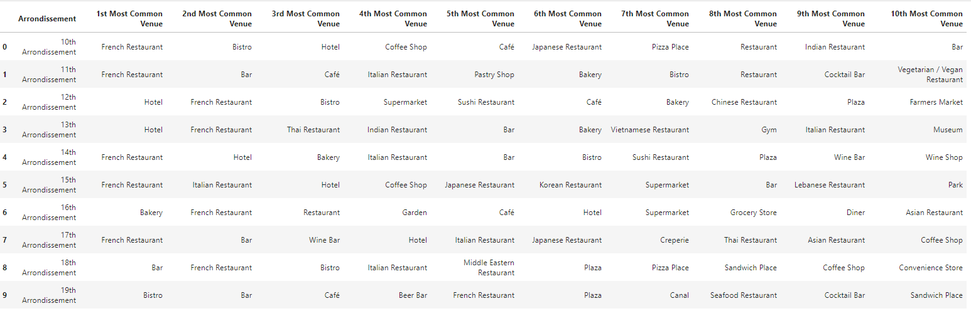
10 Most commonly visited areas in 20 Arrondissements

Slide 7
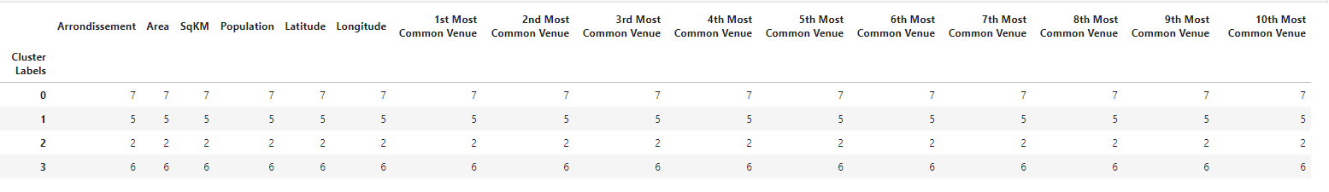
20 Arrondissements grouped into 4 Clusters

Slide 8
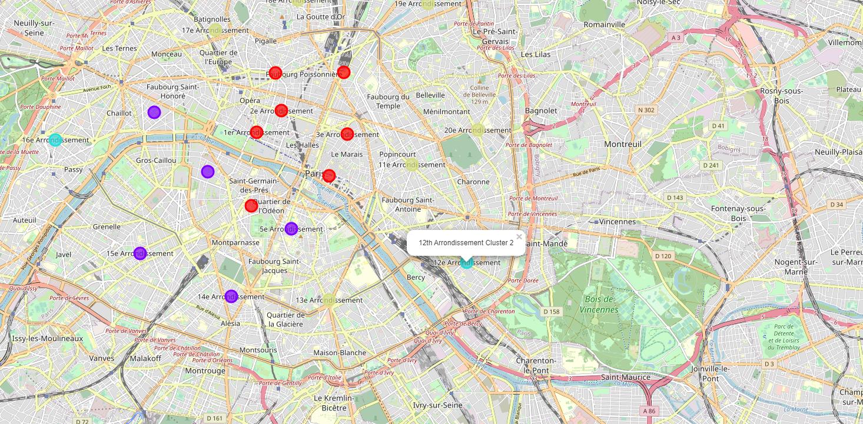
4 Clusters on the choropleth map

Slide 9
Conclusion:
For travelers:
Cluster 0 > Arrondissement (1, 2, 3, 4, 6, 9, 10): Good for French, Italian, and Asian restaurants. Great place to try some pizza and visit café. Good place to try French cuisine as there a lot of options available.
Cluster 1> Arrondissement (5, 7, 8, 14, 15): Lot of hotels surrounded by Restaurants, Plaza and Cafes. Good place to stay.
Cluster 2> Arrondissement (12 and 16): They are away from central Paris. Residential / Offical areas with supermarkets, restaurants, hotels, bakery. Secluded place and mostly not crowded.
Cluster 3> Arrondissement (11, 13, 17, 18, 19, 20): Bars, Pubs and Restaurants. Good place for some good breweries.
For business owners:
Food & Restaurant: Cluster 0. Normally crowded. Around 25k people per sqkm
Hotel/Cafe: Cluster 1. Normally crowded. Around 22k people per sqkm
Bar/Pub/Brewery: Cluster 3. Heavily crowded. Around 30K people per sqkm
Office / Apartments: Cluster 2. Less crowded. Around 9K people per sqkm

